Slide 1

RATING PREDICTION
PRESENTED BY:
RUTUJA PATIL

Slide 2
INDEX
Overview
Problem Statement
Problem Understanding
What is Rating Prediction?
Importance of Rating Prediction?
Exploratory data analysis
Visualizations
Analysis
Data Cleaning Steps
Model Building
Hyper Parameter Tuning
Saving model & predictions for Best Model
Conclusion and Test Prediction.

Slide 3
OVER VIEW FOR PREDICTION
In this Presentation we will be looking on the :
How to analyze the dataset of Rating Prediction.
What are the EDA steps in cleaning the dataset.
Overall analysis on the problem.
Model building from the train dataset.
Rating Predicting.

Slide 4
PROBLEM STATEMENT
We have a client who has a website where people write different reviews for technical products. Now they are adding a new feature to their website i.e. The reviewer will have to add stars(rating) as well with the review. The rating is out 5 stars and it only has 5 options available 1 star, 2 stars, 3 stars, 4 stars, 5 stars. Now they want to predict ratings for the reviews which were written in the past and they don’t have a rating.
So, we have to build an application which can predict the rating by seeing the review.
THIS PROJECT CONTAINS TWO PHASE:
Train Data SET
Prediction is done on the same data set

Slide 5
UNDERSTANDING PROBLEM
We have a client who has a website where people write different reviews for technical products. Now they are adding a new feature to their website i.e. The reviewer will have to add stars(rating) as well with the review. The rating is out 5 stars and it only has 5 options available 1 star, 2 stars, 3 stars, 4 stars, 5 stars. Now they want to predict ratings for the reviews which were written in the past and they don’t have a rating. So, we have to build an application which can predict the rating by seeing the review.
We have scraped more than 40000 rows of data. We have scraped the reviews of different products like laptops, Phones, Headphones, smart watches, Professional Cameras, Printers, Monitors, Home theater, Router from different ecommerce websites.
“Here We have used Amazon Website to scraping the data using Selenium and Beautiful Soup ”
Our goal is Now they want to predict ratings for the reviews which were written in the past and they don’t have a rating. So, we have to build an application which can predict the rating by seeing the review.

Slide 6
What is the importance of Rating Prediction ?
The rise in E — commerce, has brought a significant rise in the importance of customer reviews. There are hundreds of review sites online and massive amounts of reviews for every product. Customers have changed their way of shopping and according to a recent survey, 70 percent of customers say that they use rating filters to filter out low rated items in their searches.
The ability to successfully decide whether a review will be helpful to other customers and thus give the product more exposure is vital to companies that support these reviews, companies like Google, Amazon and Yelp!.
There are two main methods to approach this problem. The first one is based on review text content analysis and uses the principles of natural language process (the NLP method). This method lacks the insights that can be drawn from the relationship between costumers and items. The second one is based on recommender systems, specifically on collaborative filtering, and focuses on the reviewer’s point of view. Use of the user’s similarity matrix and applying neighbors analysis are all part of this method. This method ignores any information from the review text content analysis.

Slide 7
EXPLORATORY DATA ANALYSIS :
As a first step I have imported required basic libraries along with natural language processing libraries, and the train data set which were in csv format.
Then I did all the statistical analysis of both the data set and checked shape, n uniqueness (unique value) each column contains, data types, value counts ,size .
While checking the info of the datasets I found some null value from review columns \. Hence dropped those columns with their rows and it won’t add much to target variable.
Then while looking into the value counts I found some columns will null duplicated rows(in both the data set).
Again Null values were re-checked and found no null values, Hence missing percentage visualization were performed on null values.

Slide 8
EXPLORATORY DATA ANALYSIS :
Data Cleansing was performed, text data were converted to lower for similar identity and un-wanted symbols were removed from data set.
Pie graph was drawn to find the contents followed by others.
Stop words was being used with additional words were added to stop words for easy classification.
Lemmatization was applied on both the train and test dataset data set.
Scaling Technique was performed using TF (Term Frequency)-IDF(Inverse Document Frequency) was used to bring the data under a single scale.

Slide 9
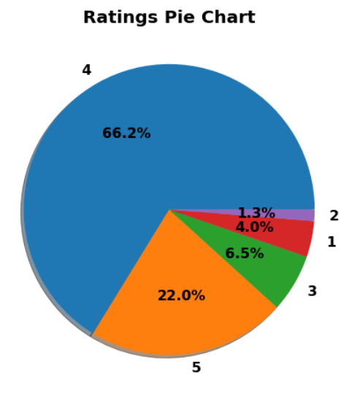
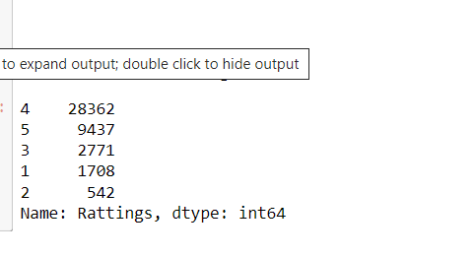
VISUALIZATION

Slide 10
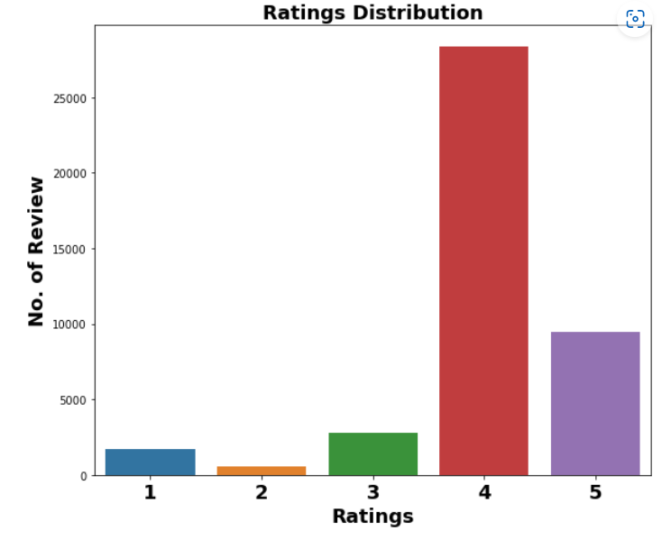
VISUALIZATION

Slide 11
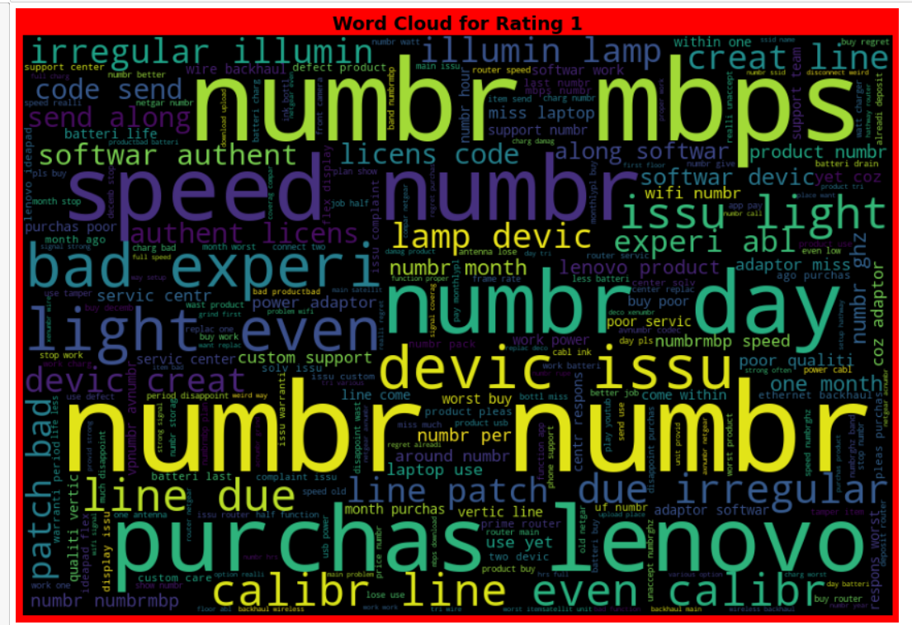
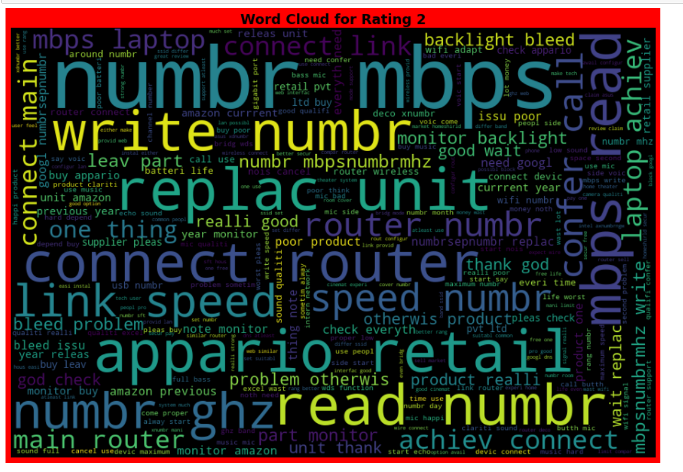
VISUALIZATION

Slide 12
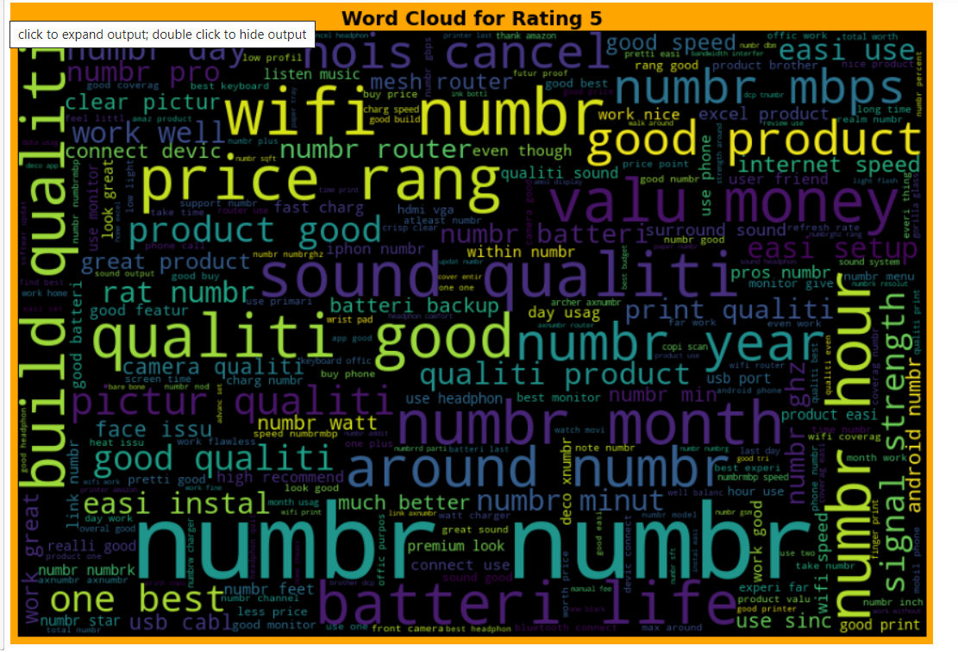
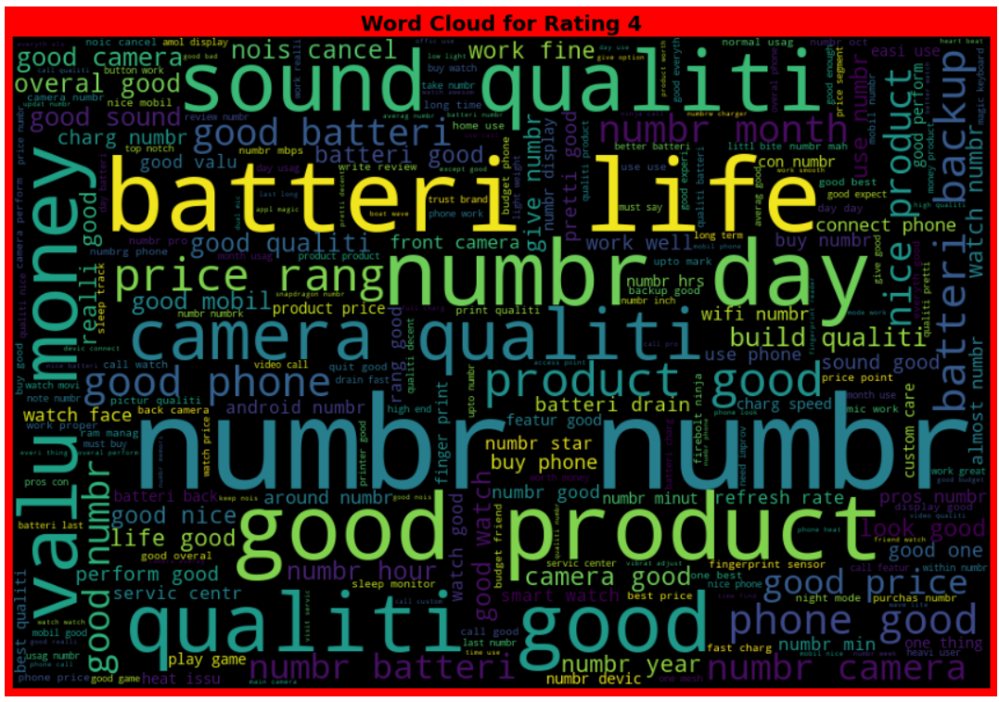
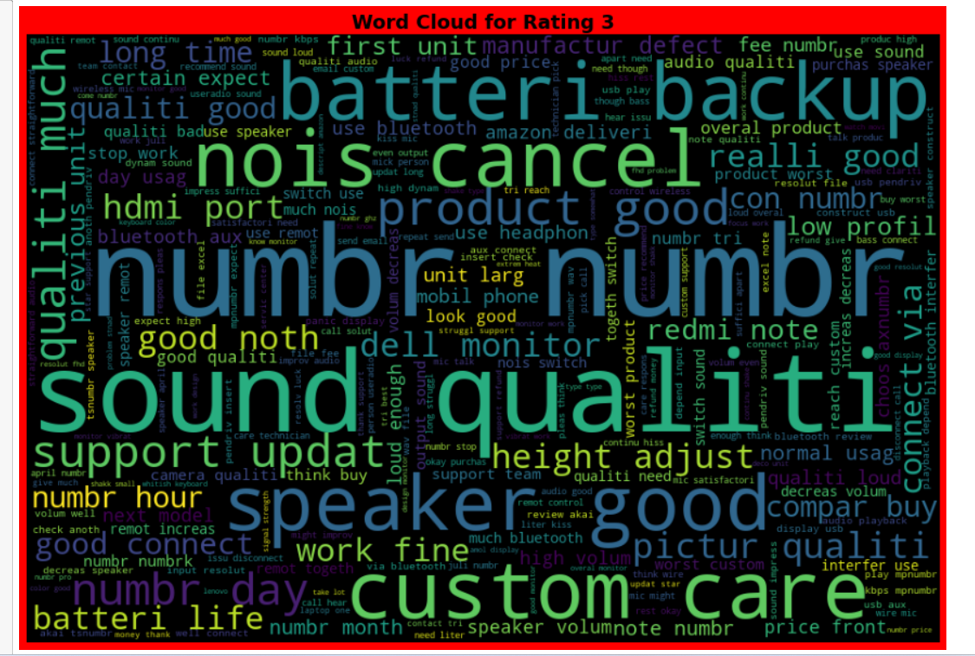
Observation

Slide 13
DATA ANALYSIS
Other than these, I used Word Cloud to see the foul words. In each columns and found maximum contains of those words within.
I have used NLTK library for Natural Language processing. The other than key was used while removing all the abnormal symbols from target variable.
I found the contains of malignant, highly malignant, rude, threat , abuse, loathe comments distribution with the help of Pie chart. An Extra bar graph was also drawn to show the distribution
Stop words was also used with more feeder words on this library to make the system more ready for classification.
Lemmatization was used to
TF-IDF(Term Frequency-Inverse Document Frequency) was used for vectorization.

Slide 14
STEPS INVOLVED
Since Label was my target and it was a categorical column so this particular problem was Logistic regression problem. And I have used all Classification algorithms to build my model.
By looking into the difference of accuracy score, f1 score and cross validation score I found Random Forest Classifier as a best model with least difference other Classifier was best too..
Also to get the best model I have to run through multiple models and to avoid the confusion of overfitting we have go through cross validation.

Slide 15
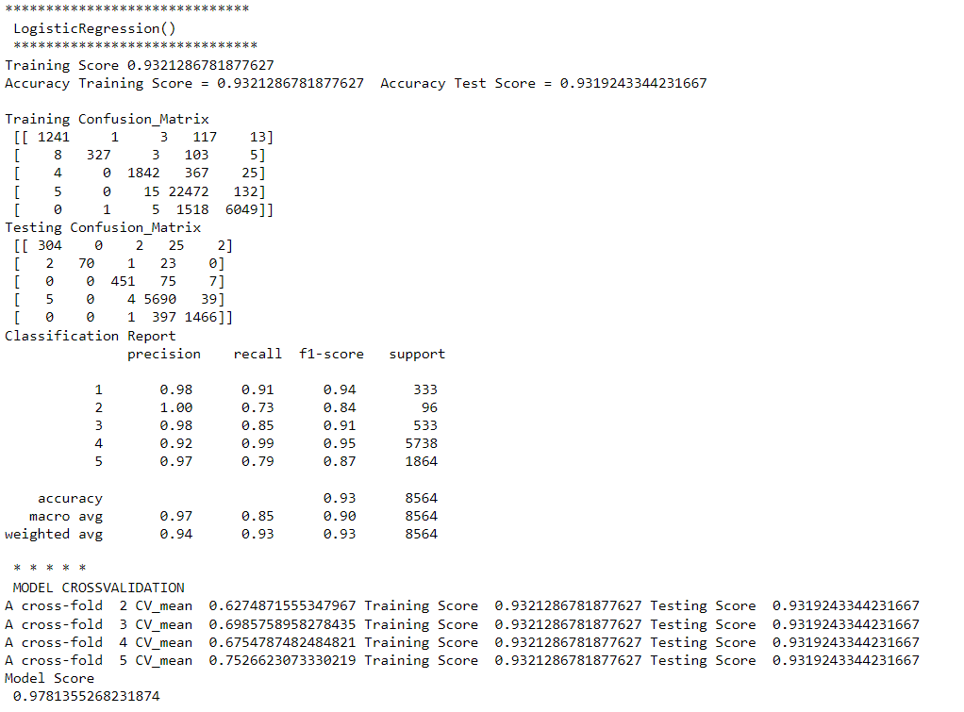
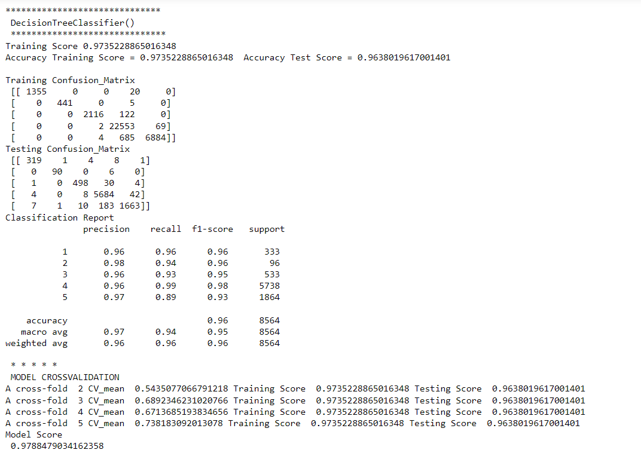
DIFFERENT MODELS WITH THEIR PERFORMANCE:

Slide 16
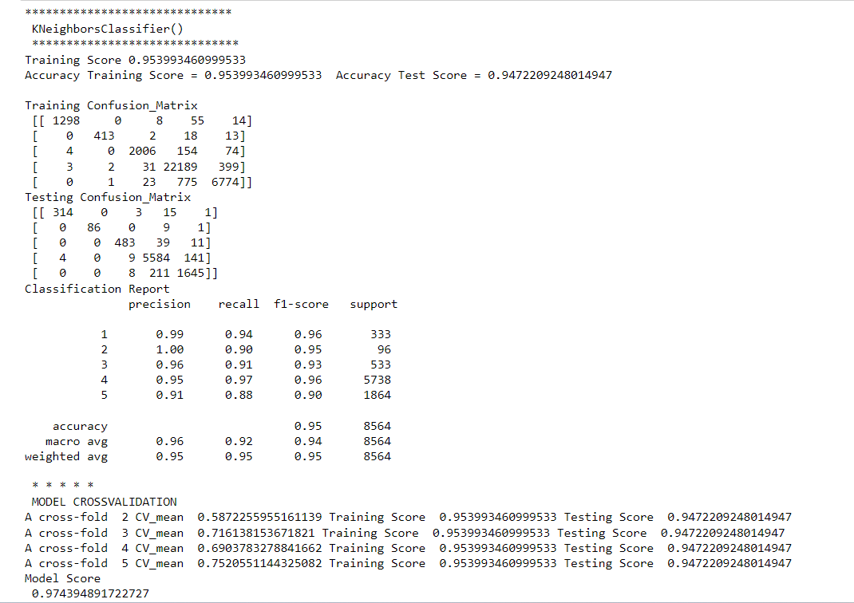
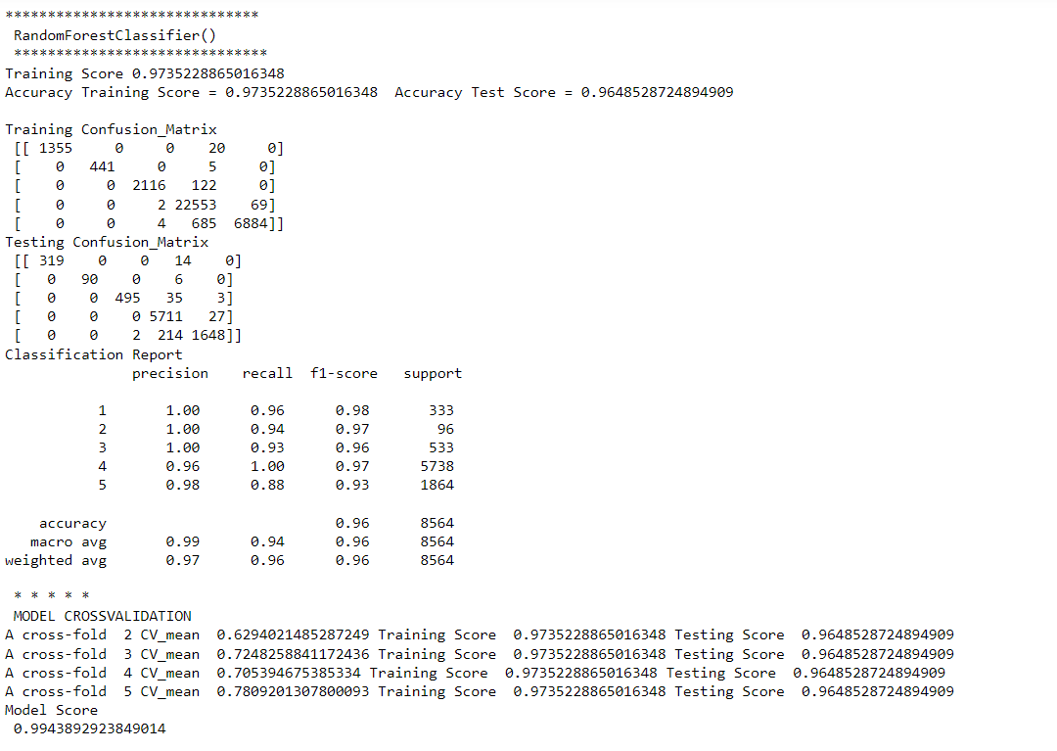

Slide 17
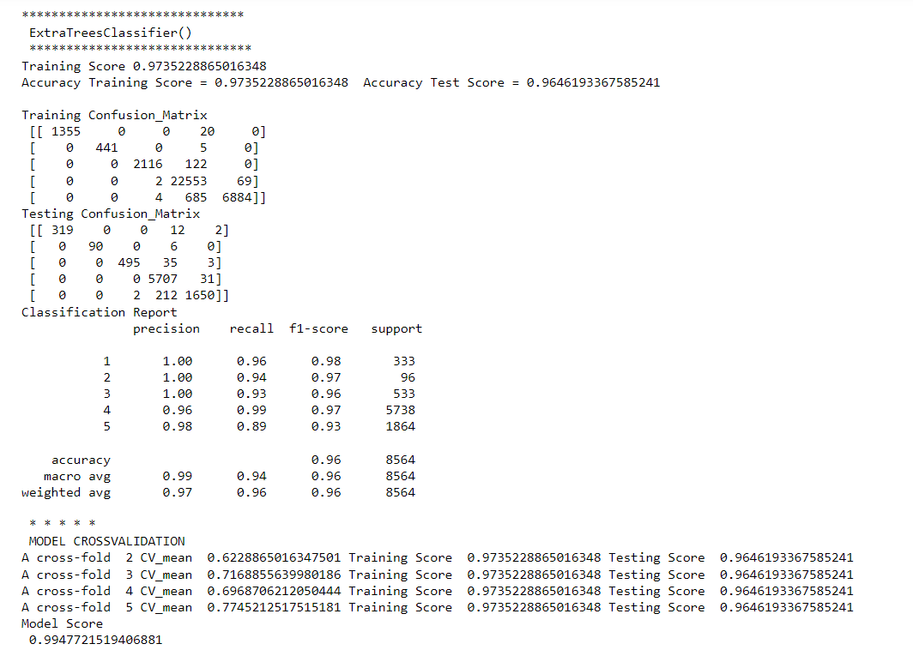
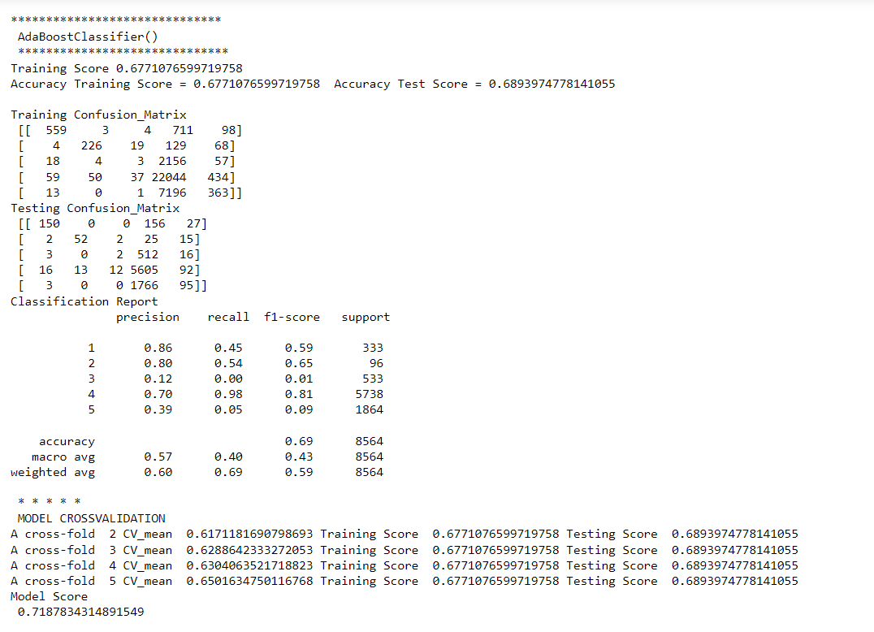

Slide 18
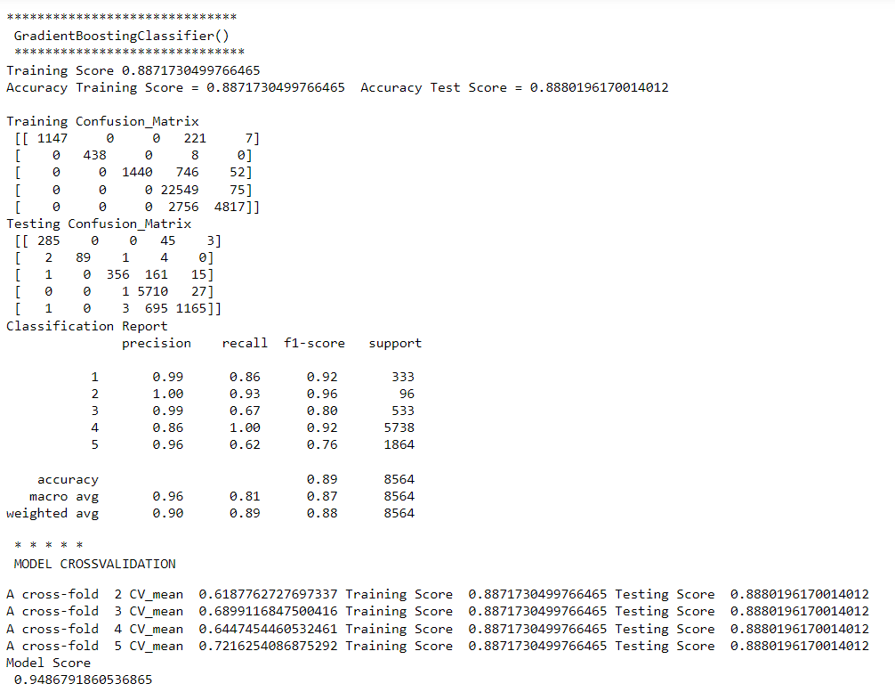

Slide 19
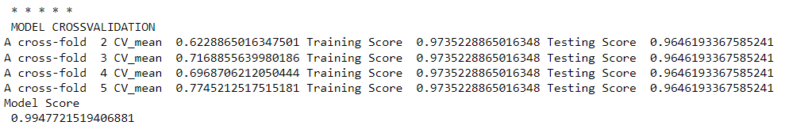
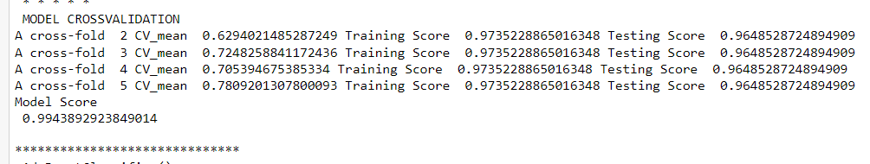
REGRESSION ALGORITHMS
Extra Trees Regressor
Random Forest Regressor

Slide 20
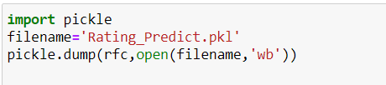
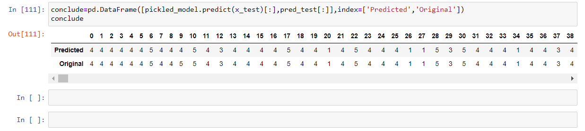
MODEL SAVING
Model Loading

Slide 21
Conclusion:
In this project report, we have used machine learning algorithms for classification for Rating Prediction .
We have mentioned the step by step procedure to analyze of the dataset .
We calculated the performance of each model using different performance metrics and compared them based on these metrics.
There were two feature present in our dataset, I analyzed the data and dropped all the necessary features.
From overall analysis and visualization I come into conclusion :
Review and Rating is the main columns in prediction

